Slide 1
Employee Data Analysis using Excel
STUDENT NAME: KALAI SELVI S
REGISTER NO: 312216777
DEPARTMENT: B.COM ACCOUNTING &FINANCE
COLLEGE: SHRI KRISHNASWAMY COLLEGE FOR WOMEN

Slide 2
PROJECT TITLE
Employee
Performance Analysis using Excel

Slide 3


AGENDA
Problem Statement
Project Overview
End Users
Our Solution and Proposition
Dataset Description
Modelling Approach
Results and Discussion
Conclusion
3/21/2024 Annual Review

Slide 4

PROBLEM STATEMENT
A problem statement on employee performance can help identify gaps in evaluating employee performance and their potential impacts.
Its difficult to evaluate employee performance . It may lead to increased errors ,higher turnover , or a reduced ability to manage improvements.

Slide 5

PROJECT OVERVIEW
The employee dataset contains various employee attributes such as employee id ,name , date of birth, gender ,education qualification, salary etc.,.
OBJECTIVES:
1.To analyze employee attendance patterns
2.Determine the count of employees by department and gender – use a bar chart to show the count of employees in each department, split by gender
3.Understand employee experience and salary
4.Investigate employee age and nationality.
5.Monitor employee performance by position –use a table to display employee details such as position, name, and sum of salary

Slide 6
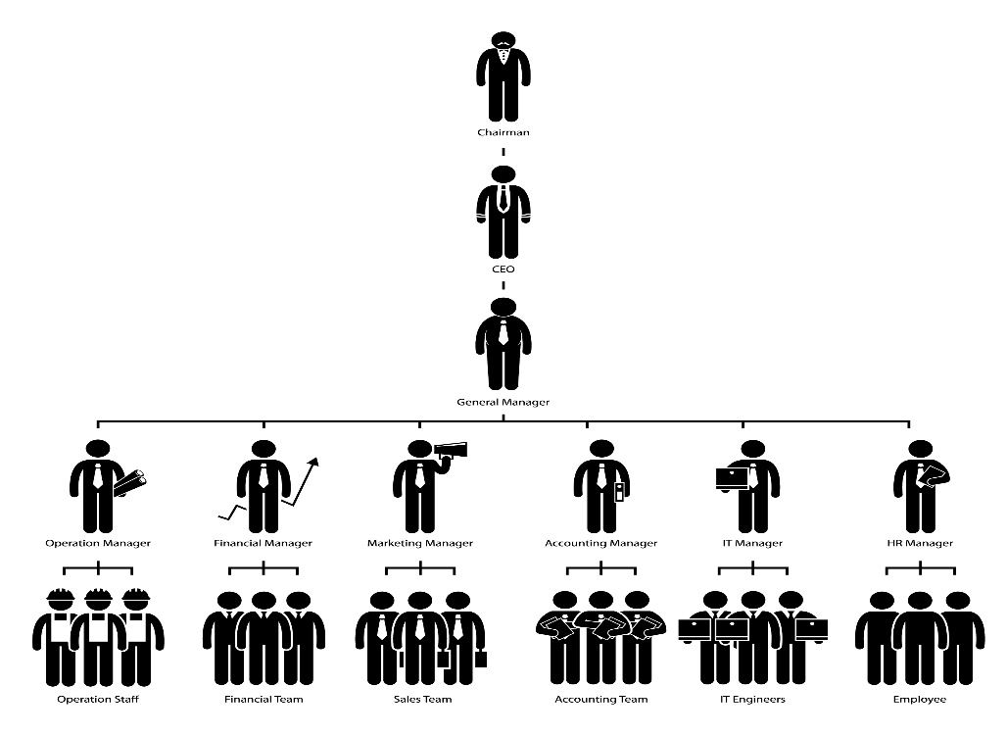

WHO ARE THE END USERS?
Researchers
Data analysts
HR professionals
managers

Slide 7

OUR SOLUTION AND ITS VALUE PROPOSITION
conditional formatting- missing
Filter-remove
Formula-performance
Pivot-summary
Graph-data visualization

Slide 8
Dataset Description
Employee-Kaggle
26-features
9-features
Employee id-number
Name-text
Employee type
Performance level
Gender-male , female
Employee rating-number

Slide 9

THE "WOW" IN OUR SOLUTION
Performance level=IFS(Z8>=5,”VERY HIGH”,Z8>=4,”HIGH”,Z8>=3,”MEDIUM”,TRUE,”LOW”)
3/21/2024 Annual Review
9

Slide 10
MODELLING
Employee dataset modeling involves creating a structured representation of data related to employees in an organization. This can include:
Personal details:
name, ID, age, gender, address, contact info
2. Job details
job title, department, location, supervisor, job description
3. Work history:
hire date, promotion dates, job changes, performance reviews
4. Skills and qualifications:
education, certifications, training, languages spoken
5. Attendance and leave:
absences, vacation days, sick leave, holidays
6. Performance metrics:
sales numbers, customer satisfaction ratings, productivity scores
7. Compensation and benefits:
salary, bonuses, health insurance, retirement plans
10

Slide 11
By creating a well-structured employee dataset, organizations can:
Improve data management and analysis
Enhance HR decision-making
Identify trends and patterns in employee data
Support strategic workforce planning
Ensure compliance with labor laws and regulations
Some common data modeling techniques used for employee dataset modeling include:
Entity-Relationship Modeling (ERM)
Object-Relational Mapping (ORM)
Data Warehousing
Dimensional Modeling

Slide 12
RESULTS
12

Slide 13
conclusion
"In conclusion, the employee dataset provides a comprehensive and structured representation of our organization's workforce data. The dataset contains [number] records and [number] attributes, covering various aspects of employee information, including personal details, job characteristics, work history, skills, performance, and compensation.
The dataset can be utilized for various purposes, such as:-
Workforce analytics and reporting
Talent management and development
Strategic workforce planning
Diversity, equity, and inclusion initiatives
Compliance and regulatory reporting
The employee dataset is a valuable asset for our organization, enabling data-driven decision-making and insights to drive business outcomes. By maintaining and updating this dataset, we can continue to leverage our workforce data to drive success and competitiveness.“
This conclusion summarizes the key aspects of the employee dataset and highlights its potential uses and benefits for the organization.

